Slide 1
Network Topology introduction
By Research Chiaos 2019/ 09 / 03

Slide 2
Basic concept

Slide 3

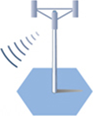

For Beginners…
A quick way to learn mobile network

Slide 4
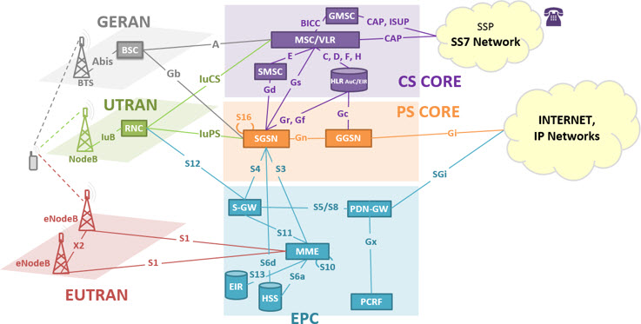
Welcome to the real world!
Notes:
base transceiver station
Radio network controller
Evolved Packet Core (EPC)

Slide 5
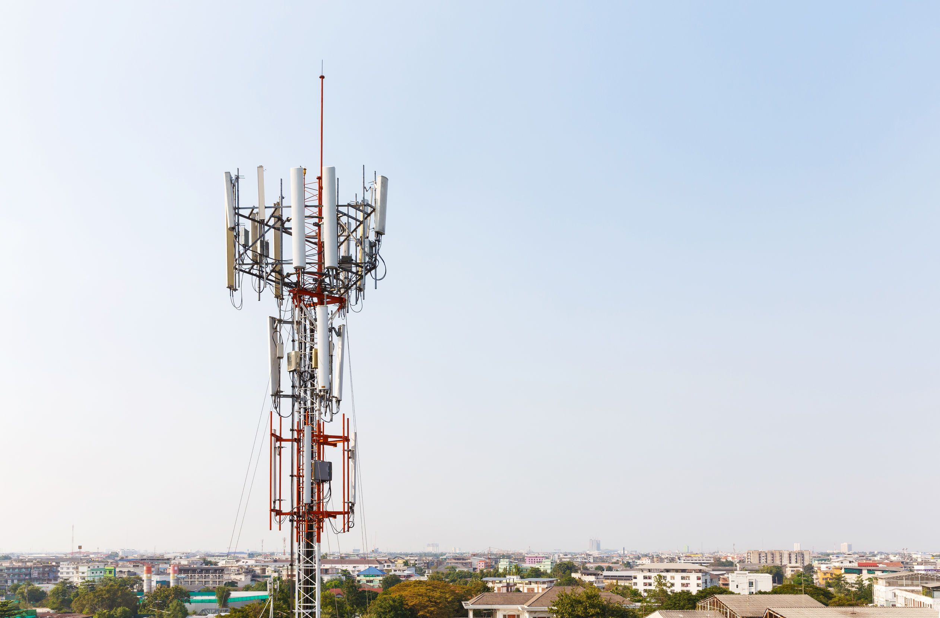
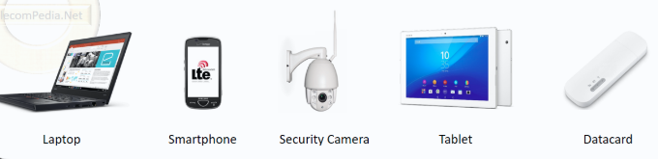
Some telecom terms
Terms in different tech
Antenna
2G
Antenna
Cell
Site
BSC
3G
Antenna
Cell
Site
RNC
Cell
4G
Antenna
Cell
Enodeb
PU
5G
Antenna
Cell
gnodeb
PU
Site
UE
(user equipment)

Slide 6
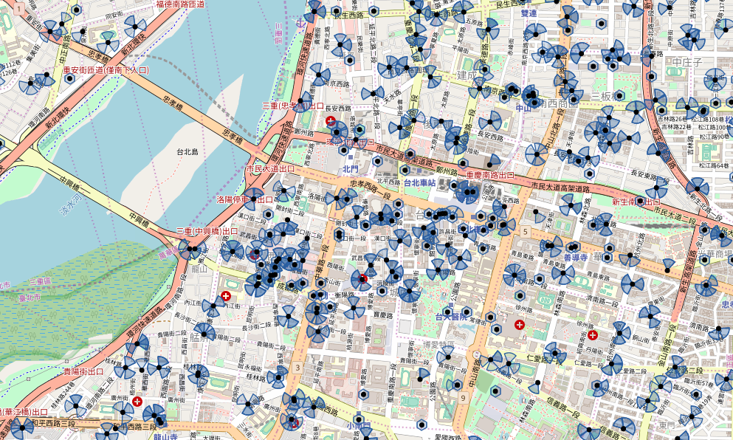
NT on the map

Slide 7
How CovMo work with NT

Slide 8
CovMo data flow
data
data
Event
Parser
NT Parser
Geo Engine
(Positioning)
AWK
(aggregation)
Optimization
Data base
GUI

Slide 9
CovMo Input Data Source
Item | Data Type | Data Source
1 | Trace Data | GPEH, CTR, CTUM, PCHR/MR, UCHR, MME, CHR, eNB (eNodeB) maxdepth trace
2 | Network Topology (SITE DB) | Cell/Site Planning Data/ MNIS/SIMS/
3 | Configuration Management Data (CM) | Eric OSS- .xml Huawei U2000-CFGMML.txt
Vendors: Ericsson / Huawei / NSN (Nokia) / ALU / ZTE …

Slide 10
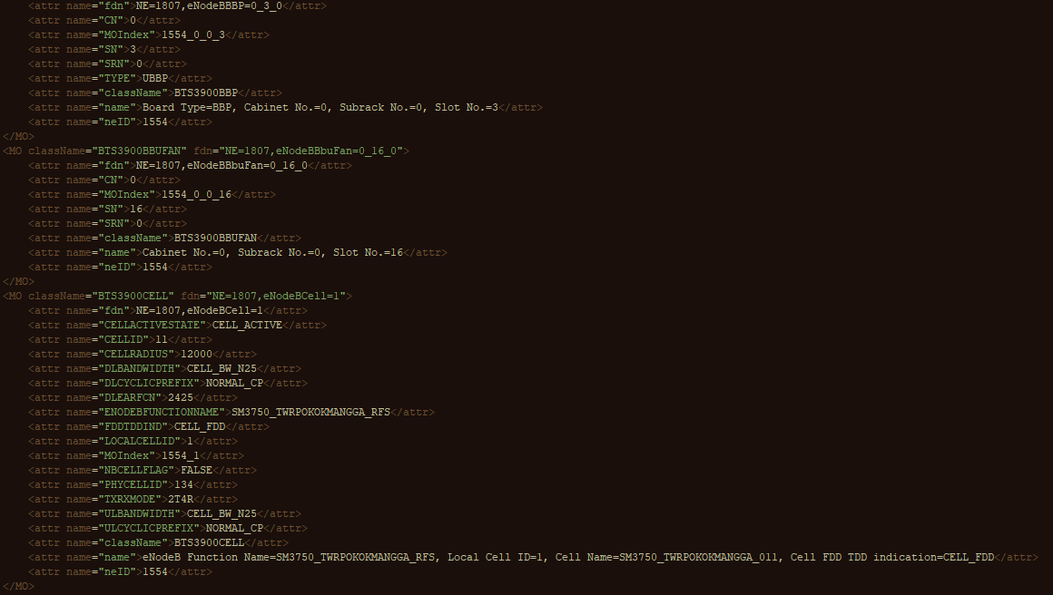
Have a look - CM file

Slide 11
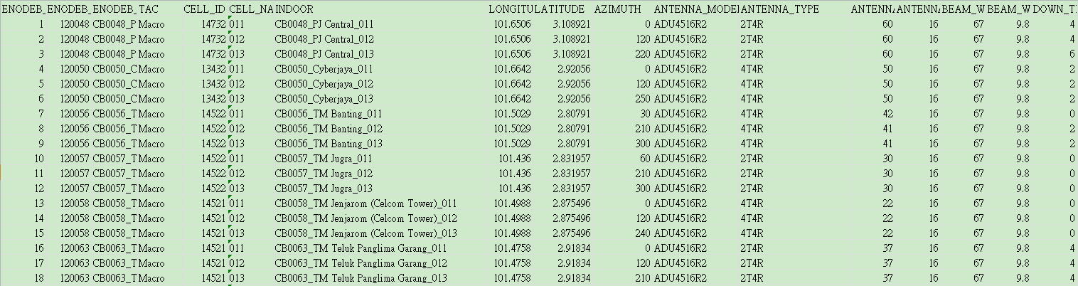
Have a look – site DB

Slide 12

NT1 flow (NT Parser output)
Source
file
Parser output
Merge
NT
NT Parser
V3_Ericsson_CM_Parser_GSM.py
V3_Ericsson_CM_Parser_LTE.py
V3_Ericsson_CM_Parser_UMTS.py
V3_Huawei_CM_Parser_GSM.py
V3_ Huawei _CM_Parser_LTE.py
V3_ Huawei _CM_Parser_UMTS.py
…. Etc
CM file
- E///
- HUAWEI
- ALU
- NSN
- ZTE
SITE_DB
SIMS
MNIS
(csv file)
NT_CELL.csv
NT_ANTENNA.csv
NT_NEIGHBOR.csv
NT_RNC.csv
NT_CELL_LTE.csv
NT_ANTENNA_LTE.csv
……etc
ALU_LTE
ALU_UMTS
ALU_GSM
NSN_LTE
NSN_UMTS
…etc

Slide 13

NT2 flow (Hilo)
Parser output
(Hilo Input)
create
voronoi
Hilo_input& covmo config
Hilo output
Load to DB
NT Hilo
●
NT_Hilo_pu_
enodeb_mapping.py
Voronoi_all.jar
NT_CELL.csv
NT_ANTENNA.csv
…
NT_VORONOI_GSM.csv
NT_VORONOI_UMTS.csv
NT_VORONOI_LTE.csv
NT_CELL.csv
NT_ANTENNA.csv
…
…
NT_VORONOI_UMTS.csv
…
●
NT_Hilo_GSM.py
NT2_CELL_UMTS.csv
NT2_ANTENNA_UMTS.csv
…
NT2_NBR_VORONOI_UMTS.csv
NT2_CLUSTER_UMTS.csv
NT2_ANTENNA_INFO.csv
●
NT_Hilo_UMTS.py
Database
●
NT_Hilo_LTE.py
●
NT_Hilo_
antenna_info.py
dim_mnc.csv
sys_mcc.csv
dim_cluster_group.csv
dim_sub_region_mapping.csv

Slide 14

NT terms
Cell key
Location
ENODEB_ID
CELL_ID
LONGITUDE
LATITUDE
Antenna parameters
Cell property
AZIMUTH
GAIN
POWER
BEAM
TILT
MODEL
…
INDOOR
ENODEB_NAME
CELL_NAME
VENDOR
REGION
…
Frequency
Cell identity
DL_EARFCN
BWCHANNEL
EUTRABAND
…
PCI
RSI
…

Slide 15
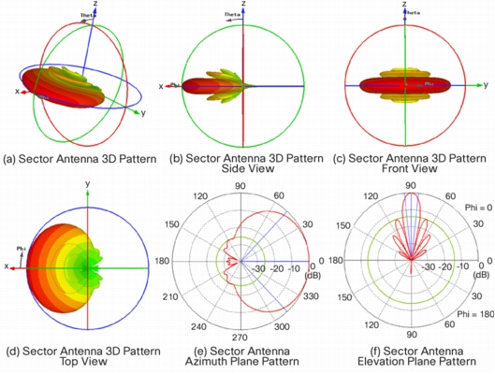
NT terms – antenna pattern

Slide 16
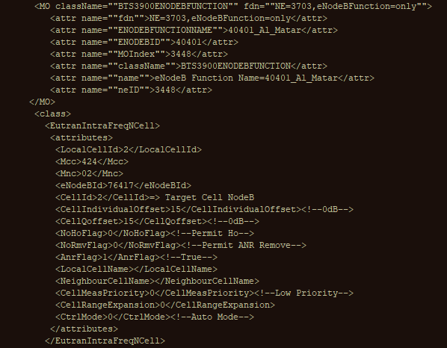

NT terms – Neighbor (LTE)
CM neighbior
Voronoi neighbor

Slide 17
NT terms – Neighbor (LTE)
CM neighbior
Voronoi neighbor
ME
My NBR
Not NBR

Slide 18
Have a look!
Csv: \\internal1\temp\Chiaos\NT_Introduction
Schema: \\192.168.3.242\Project3\CovMo\TableSchema\NT

